Slide 1
AYITI ANALYTICS
“Determinants of abortion choice: The Case of Women Aged 15-49.
Presenter: Chrismond Versailles

Slide 2

Table of methodology
OVERVIEW OF KEY IDEAS
Problem and the audience. Methodology
Results Recommandations Conclusion
References & Appendices

Slide 3
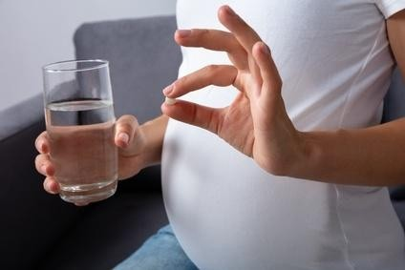
Problem and the audience.
Abortion is the interruption, before its term, of the gestation process. Abortion is a topic of concern to demographers and health care providers, as unsafe abortion is a major cause of maternal mortality (WHO, 2011), and the health consequences of abortion remain a major issue in many countries.
The audience concern by this problem:
- All women.
- Public authorities.
- Ministry of Public Health and Population.
- International organizations/donors and NGOs working in the field of reproductive health and human rights, especially women's rights.

Slide 4
METHODOLOGY

Slide 5
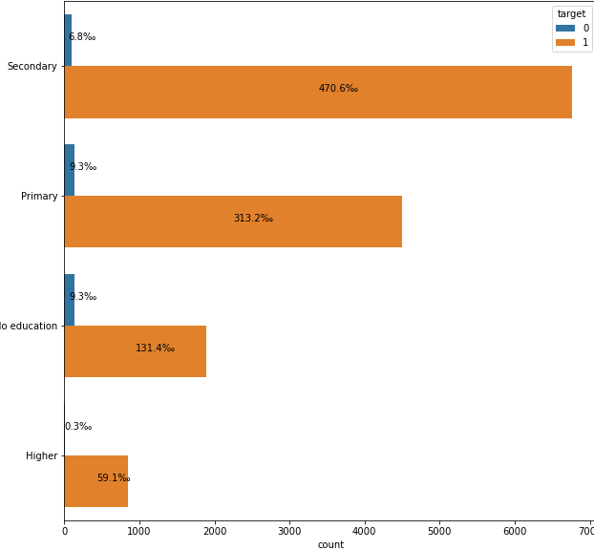
Results
Interpretation
.

Slide 6
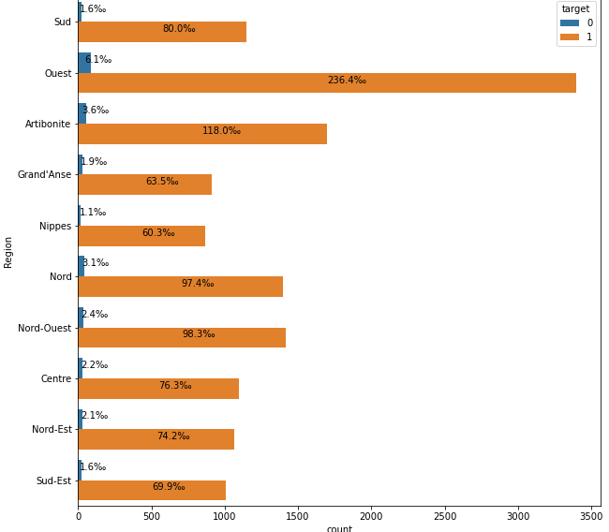
Results
The west department is the region where there is the most abortion to know 470.6‰ then comes Artibonite then the North-west

Slide 7
Results
This graph highlights the religion and education level of those who had abortions.

Slide 8
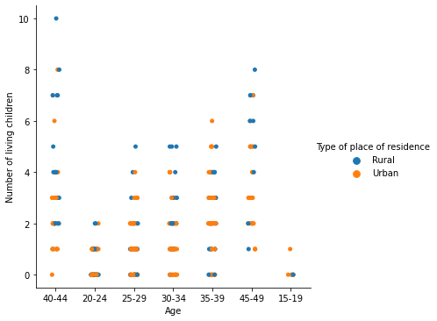
Results
Women who have already had an abortion in rural areas have more children than in urban areas and the older the woman, the more children she
has.

Slide 9
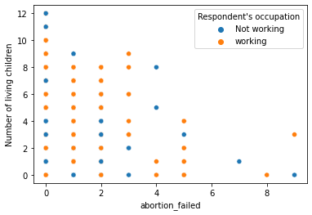
Results
There is a relationship between the number of failed abortions and the number of living children; this relationship is proportional.

Slide 10
Recommendations
GLOBAL PERSPECTIVE
1) comprehensive sexuality education that includes medically accurate information about abstinence and contraception especially after primary school and also in a religious environment.
2) Insurance coverage of and public funding for family planning services.
3) Greater access to emergency contraception (which prevents pregnancy and does not cause abortion).
4) Programs that curb domestic violence and sexual abuse.

Slide 11
Conclusion
Top features
- Religion
- Education level
- The area
- Current marital status
The topics from the columns topicIds and relevantTopicIds could not be used in our project. To extract the topics we needed to use the Freebase API which had to be integrated with our project code. This was causing few issues as there were a few requisites for the integration. With proper integration and extraction these features can be used in the future expansion of the project.

Slide 12
Talk to Us
Mailing Address
123 Anywhere St., Any City, State, Country 12345
Phone Number
(123) 456 7890
E-mail Address
hello@reallygreatsite.com

